Slide 1


CMR COLLEGE OF ENGINEERING AND TECHNOLOGY
Zoo Management System
Name: G. Keerthi Reddy-22H51A0520
G.Ajay-22H51A0522
G.Krishnapriya-22H51A0525
Sec: CSE-C
Guide: MS . Archana Bathula

Slide 2
CONTENTS:
ABSTRACT
KEY OBJECTIVES
INTRODUCTON
IMPLEMENTATION
EXISTING SOLUTIONS
PROBLEM DEFINITION
TECHNOLOGIES USED
ADVANTAGES
CONCLUSION

Slide 3
Abstract:
This abstract introduces a Zoo Management System aimed at improving operational efficiency and visitor experiences in zoological institutions. By allowing users to easily access detailed information about animals through name-based searches, the system streamlines data retrieval for both staff and visitors.
Using modern web technologies like HTML, CSS, and React.javascript for the frontend, and Python with Django for the backend, the system ensures a user-friendly interface and secure server-side operations.Data about zoo animals is efficiently managed using a relational database management system (RDBMS), with integration capabilities for accessing additional animal information from external APIs.

Slide 4
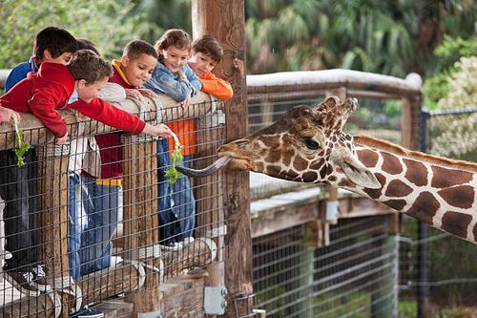
Key Objectives:
Develop a user-friendly interface for entering animal names and retrieving details.
Implement a backend system to efficiently manage and retrieve animal information.
Ensure the accuracy, completeness, and timeliness of the information provided.
Enhance visitor experiences by providing educational and engaging content about zoo animals.
Improve operational efficiency within the zoo by reducing the time and effort required for data retrieval tasks.

Slide 5
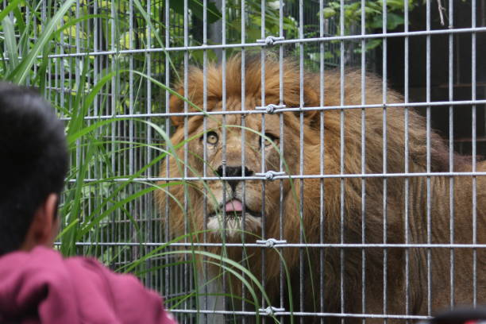
Introduction to Zoo Management System
A zoo management system is a software tool used by zoos to efficiently manage their operations.
It allows users to search for specific animals within the zoo and retrieve detailed information about them.
This system enhances the overall visitor experience by providing comprehensive information about the zoo's inhabitants.

Slide 6
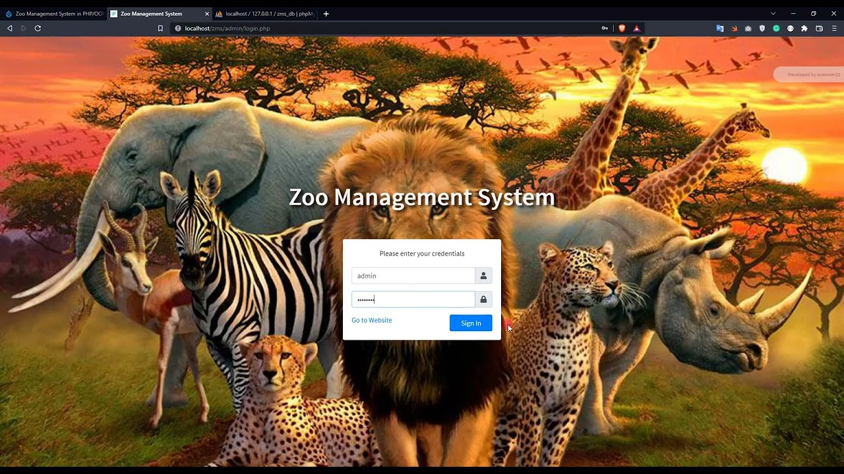
Implementation of Animal Search Feature
The animal search feature can be integrated into the zoo's existing website or mobile app for easy access.
Zoo staff can regularly update the database with new information and animal profiles.
The search functionality can be customized to allow for easy filtering by species, habitat, or conservation status.

Slide 7

User Interface and Experience
The user interface of the animal search feature should be user-friendly for visitors of all ages.
Visitors should be able to easily navigate through the system to find the information they are looking for.
Interactive elements such as photos, videos, and fun facts can enhance the user experience and make learning about animals more engaging.

Slide 8
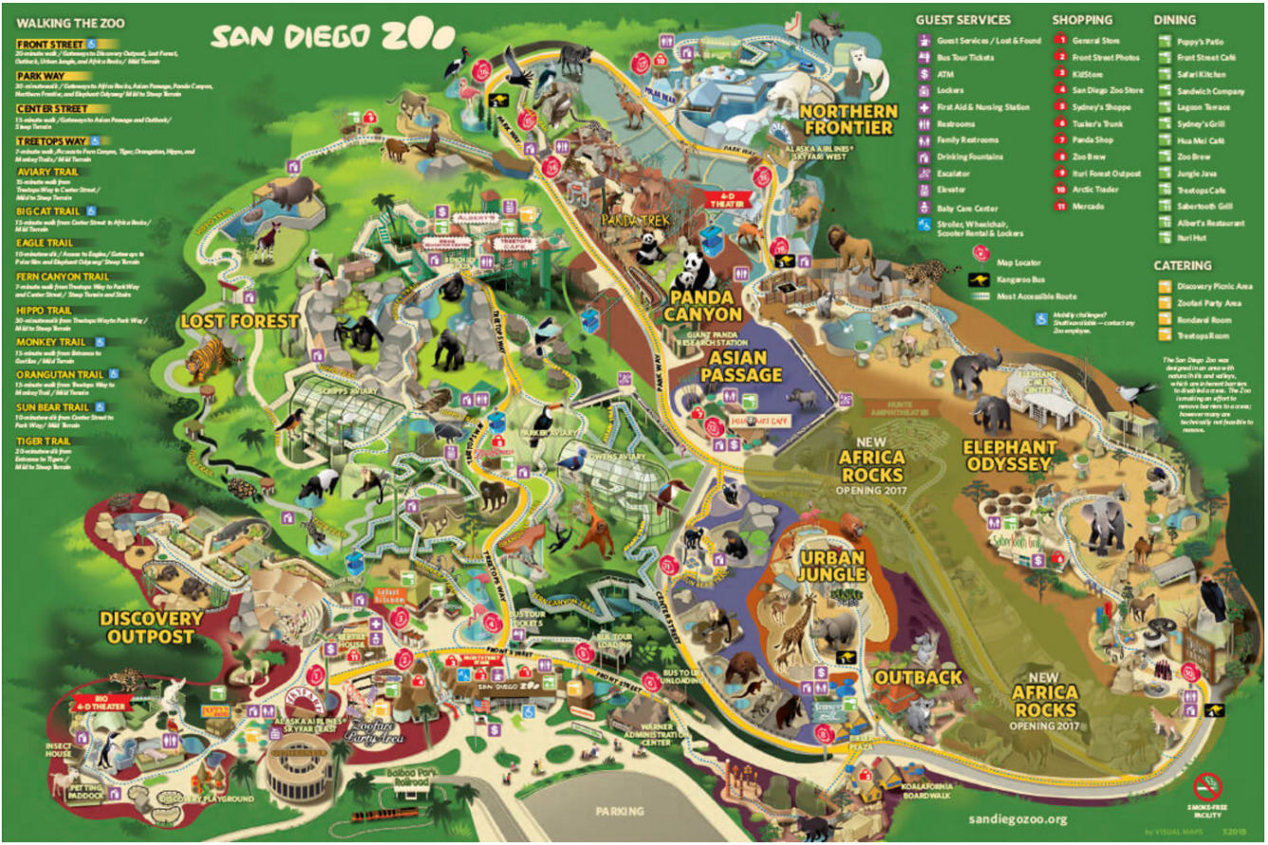
Data Management and Security:
The zoo management system should have robust data management capabilities to ensure the accuracy and integrity of animal information.
Data security measures should be in place to protect sensitive information and prevent unauthorized access.
Regular backups and updates should be performed to safeguard data and ensure the smooth operation of the system.

Slide 9
Exisiting Solutions:
ZooEasy: ZooEasy is a software solution designed specifically for managing animal collections in zoos, aquariums, and wildlife parks.
ZooMIS (Zoo Management Information System): ZooMIS, developed by the European Association of Zoos and Aquaria (EAZA), offers a customizable platform for managing various aspects of zoo operations, including animal records, husbandry, and breeding programs. It also provides tools for visitor management, education, and conservation efforts.
ZIMS (Zoological Information Management System):ZIMS, developed by Species360.It offers modules for animal records management, medical care, population management, and research collaboration, as well as integration with global conservation databases.

Slide 10
Problem Definition:
Zoos play a vital role in conservation, education, and entertainment, but managing the diverse array of tasks within a zoo efficiently can be challenging. One significant aspect is providing visitors with accurate and accessible information about the animals they encounter. Currently, accessing detailed information about zoo animals often requires manual searches or reliance on paper-based records, leading to inefficiencies and potentially inaccurate or outdated information.
To address this issue, the goal is to develop a Zoo Management System that allows users to enter the name of an animal and quickly retrieve relevant details. The system should streamline data retrieval for zoo staff and visitors, providing accurate and up-to-date information about the zoo's animal collection in a user-friendly manner.

Slide 11
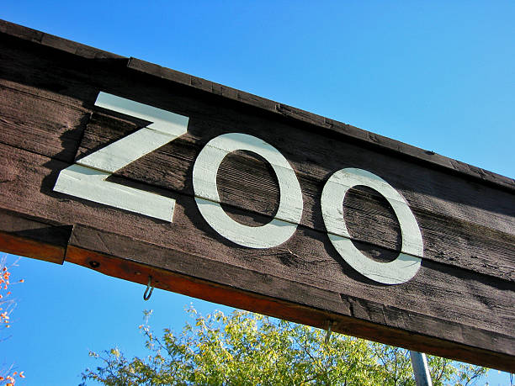
Technologies Used:
To create a Zoo Management System where users can enter the name of an animal and retrieve its details, you'll need a combination of frontend and backend technologies along with a database to store and retrieve animal information. Here's a breakdown of the technologies you could use for different components of the system:
Frontend Development:
HTML/CSS for structure and styling.
JavaScript for interactivity. Angular for dynamic
Backend Development:Python (Django/Flask),or Java for server-side logic.RESTful API for communication between frontend and backend.Authentication mechanisms for security.
Database:MySQL, PostgreSQL, or SQLite for storing animal data.

Slide 12
Advantages:
Efficient Information Retrieval: Visitors and staff can quickly access detailed information about zoo animals by simply entering their names, reducing the time and effort required for data retrieval.
Enhanced Visitor Experience: Visitors can learn more about the animals they encounter during their zoo visit, enriching their experience and fostering a greater appreciation for wildlife conservation.
Improved Animal Welfare: Zookeepers and veterinary staff can easily access and update animal records, ensuring that animals receive appropriate care and attention based on their individual needs.
Streamlined Operations: The system simplifies administrative tasks related to animal management, reducing paperwork and manual data entry for zoo staff and allowing them to focus more on animal care and conservation efforts.

Slide 13
Conclusion:
The Zoo Management System provides an efficient solution for zoo operations, visitor engagement, and conservation efforts. Its user-friendly interface, powered by modern web technologies, simplifies data retrieval for both staff and visitors. Integration with external APIs enhances the system's capabilities, while cloud deployment ensures scalability and reliability. Overall, the system represents a significant advancement in zoo management practices, promising to improve operational efficiency and conserves times.

Slide 14
